Slide 1
Reworking
Born Digital Processing
Centralizing Workflows at UNC-CH Libraries, Wilson Special Collections
Jessica Venlet | @jessvenlet | August 2, 2019| SAA Research Forum
Text & Slides: https://bit.ly/2SYdNIB

Slide 2
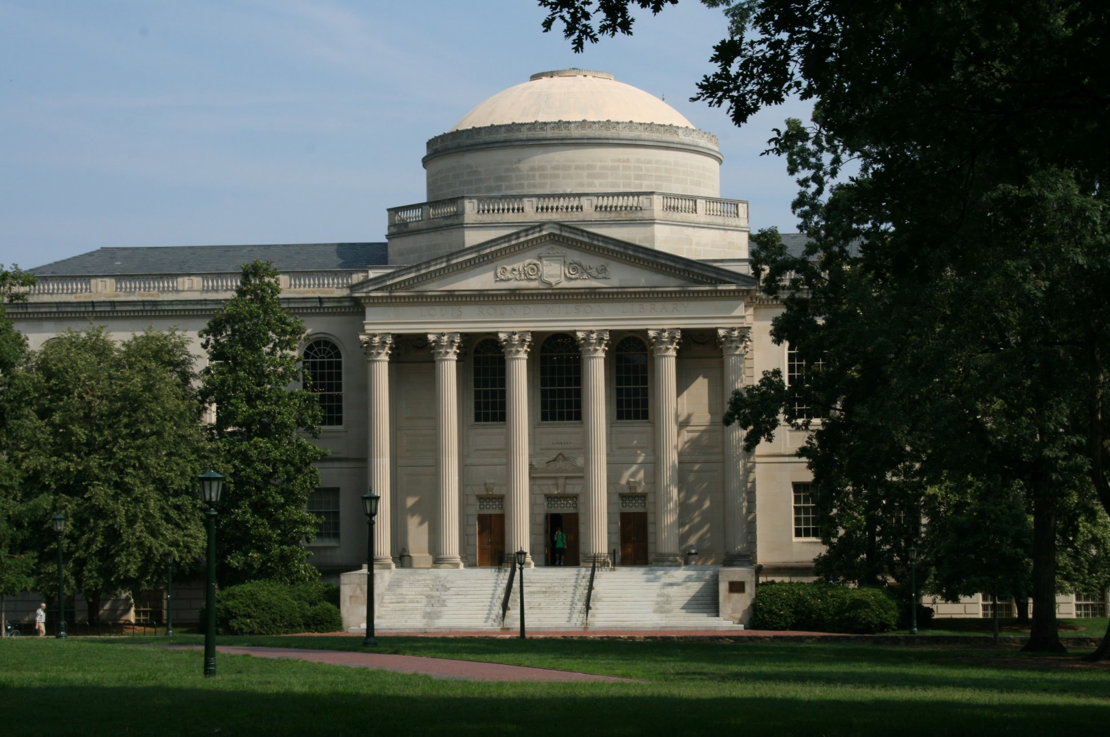
Context
The Wilson Special Collections Library @ UNC-CH Libraries
Jessica Venlet | @jessvenlet | August 2, 2019 | SAA Research Forum

Slide 3
Some Questions...
How can we create a consistent pre-ingest workflow? How can we reduce the number of people responsible for really technical bits?
What’s the right model for staffing the processing and ingest of born-digital at our institution?
What’s the right role for graduate student workers?
Can a centralized service help with appraisal before ingest? Can it help connect born-digital work with our new Intake/Accessioning process?
Jessica Venlet | @jessvenlet | August 2, 2019 | SAA Research Forum

Slide 4
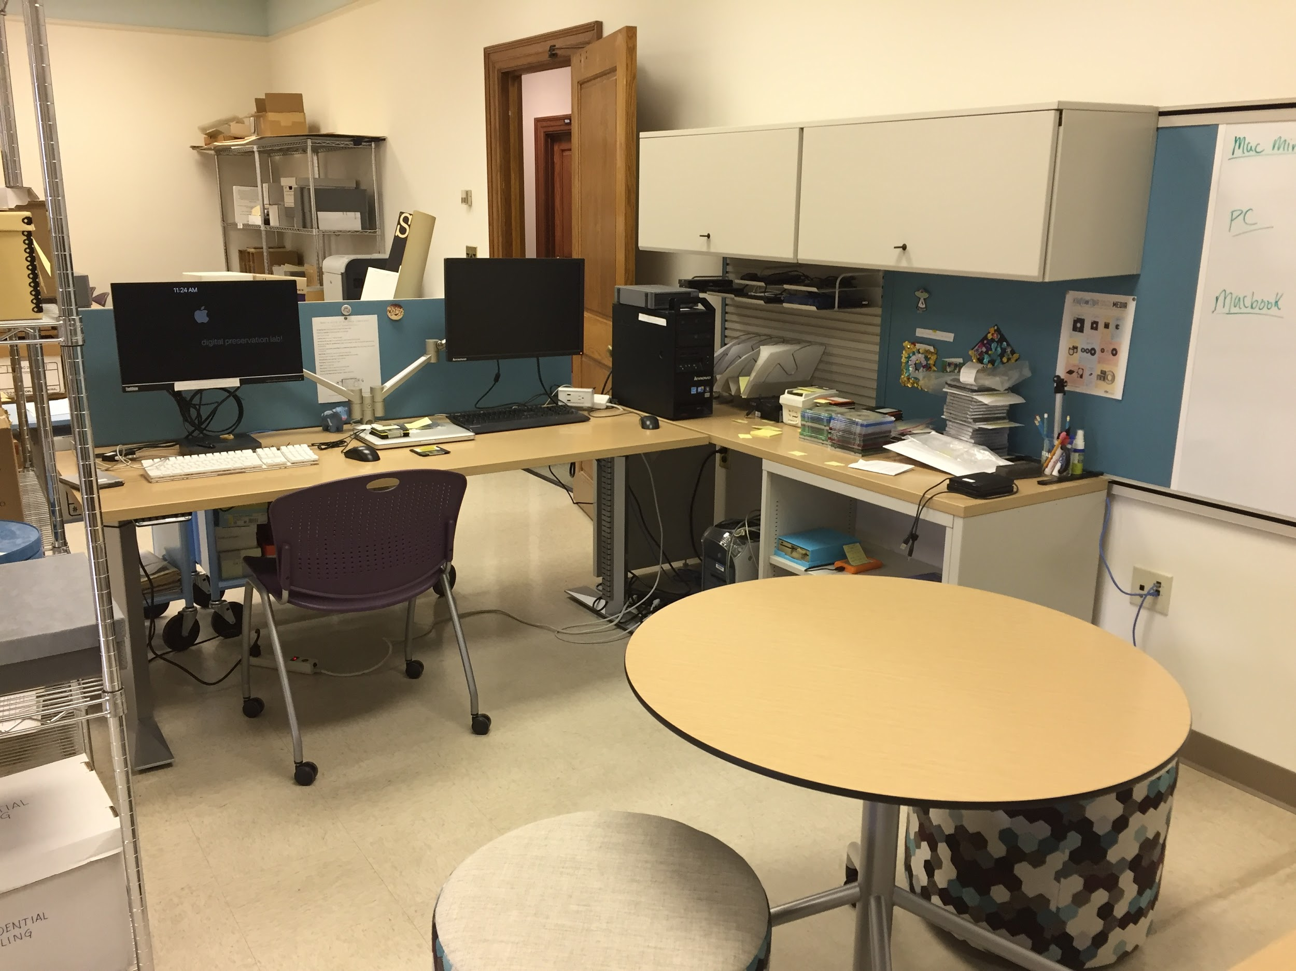
Centralizing
in the Digital Preservation “Lab”
Blog Posts:
3D Printing and the Lab
Workflows Bit by Bit
Jessica Venlet | @jessvenlet | August 2, 2019 | SAA Research Forum

Slide 5
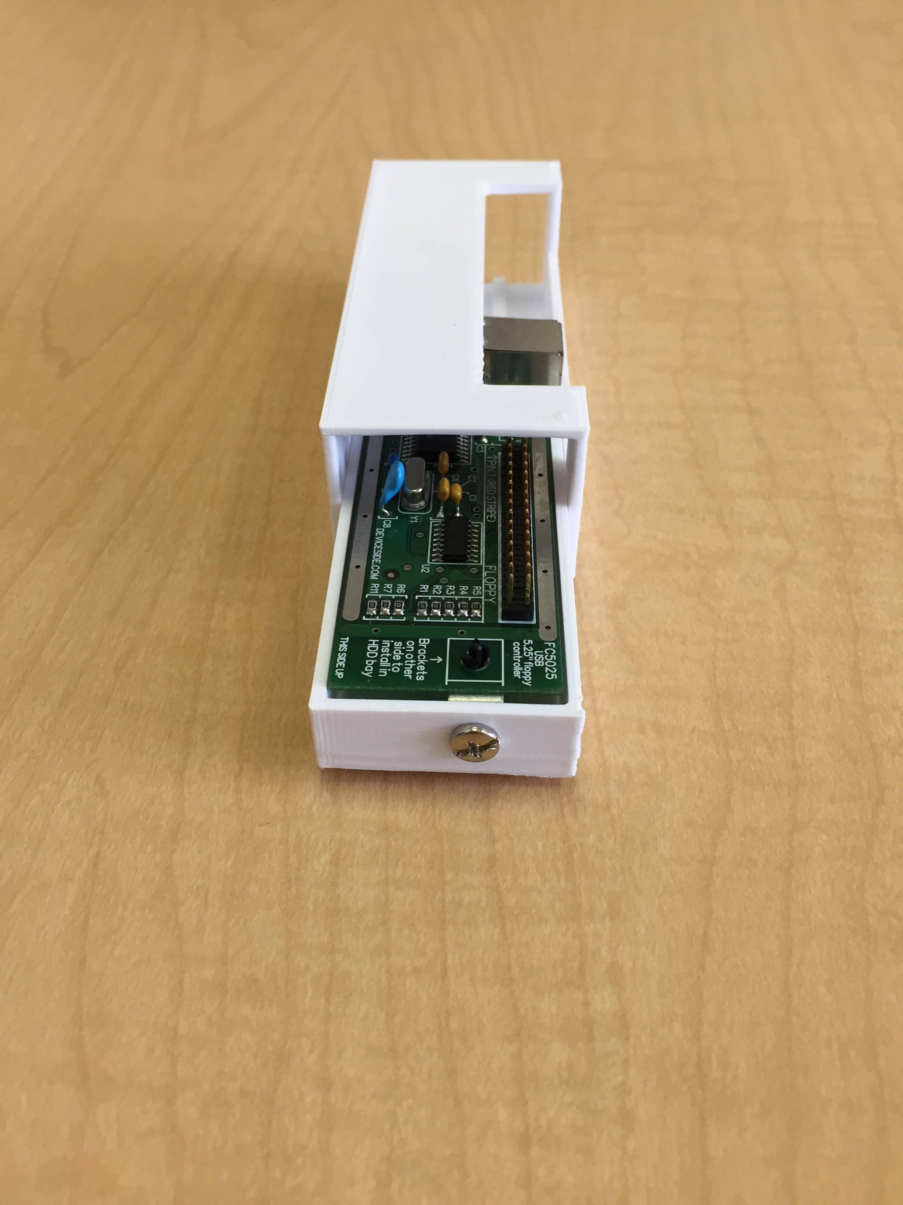
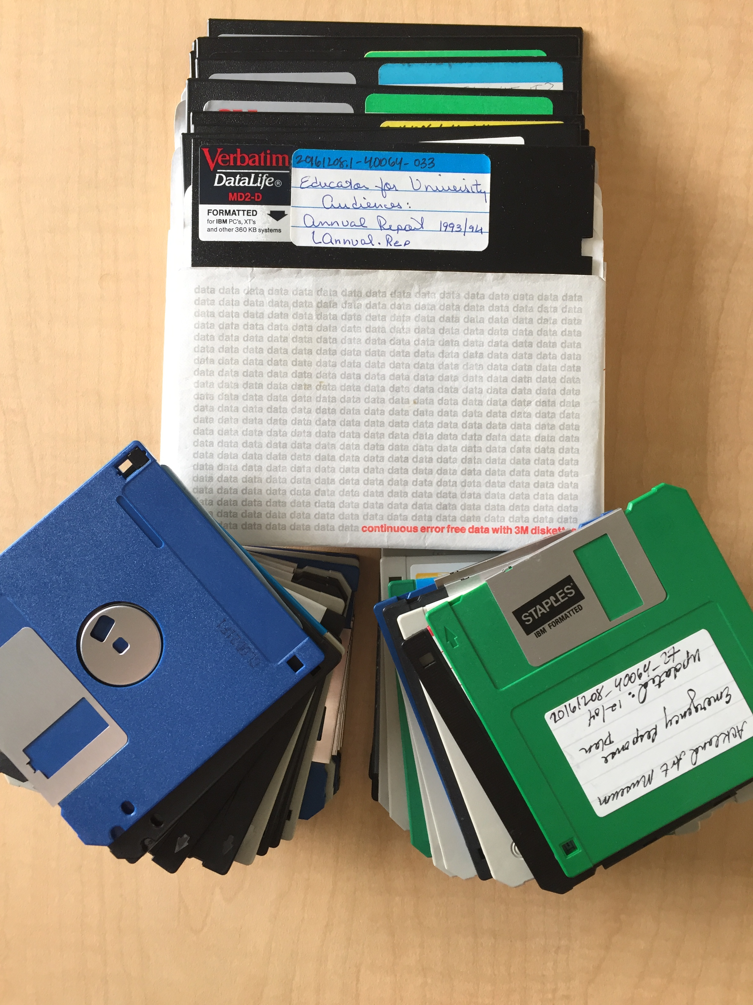
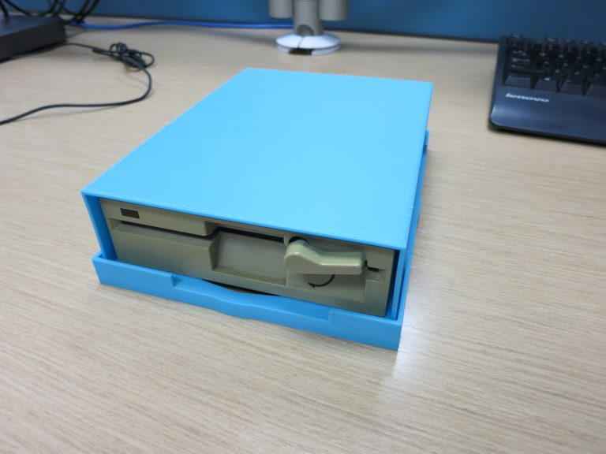
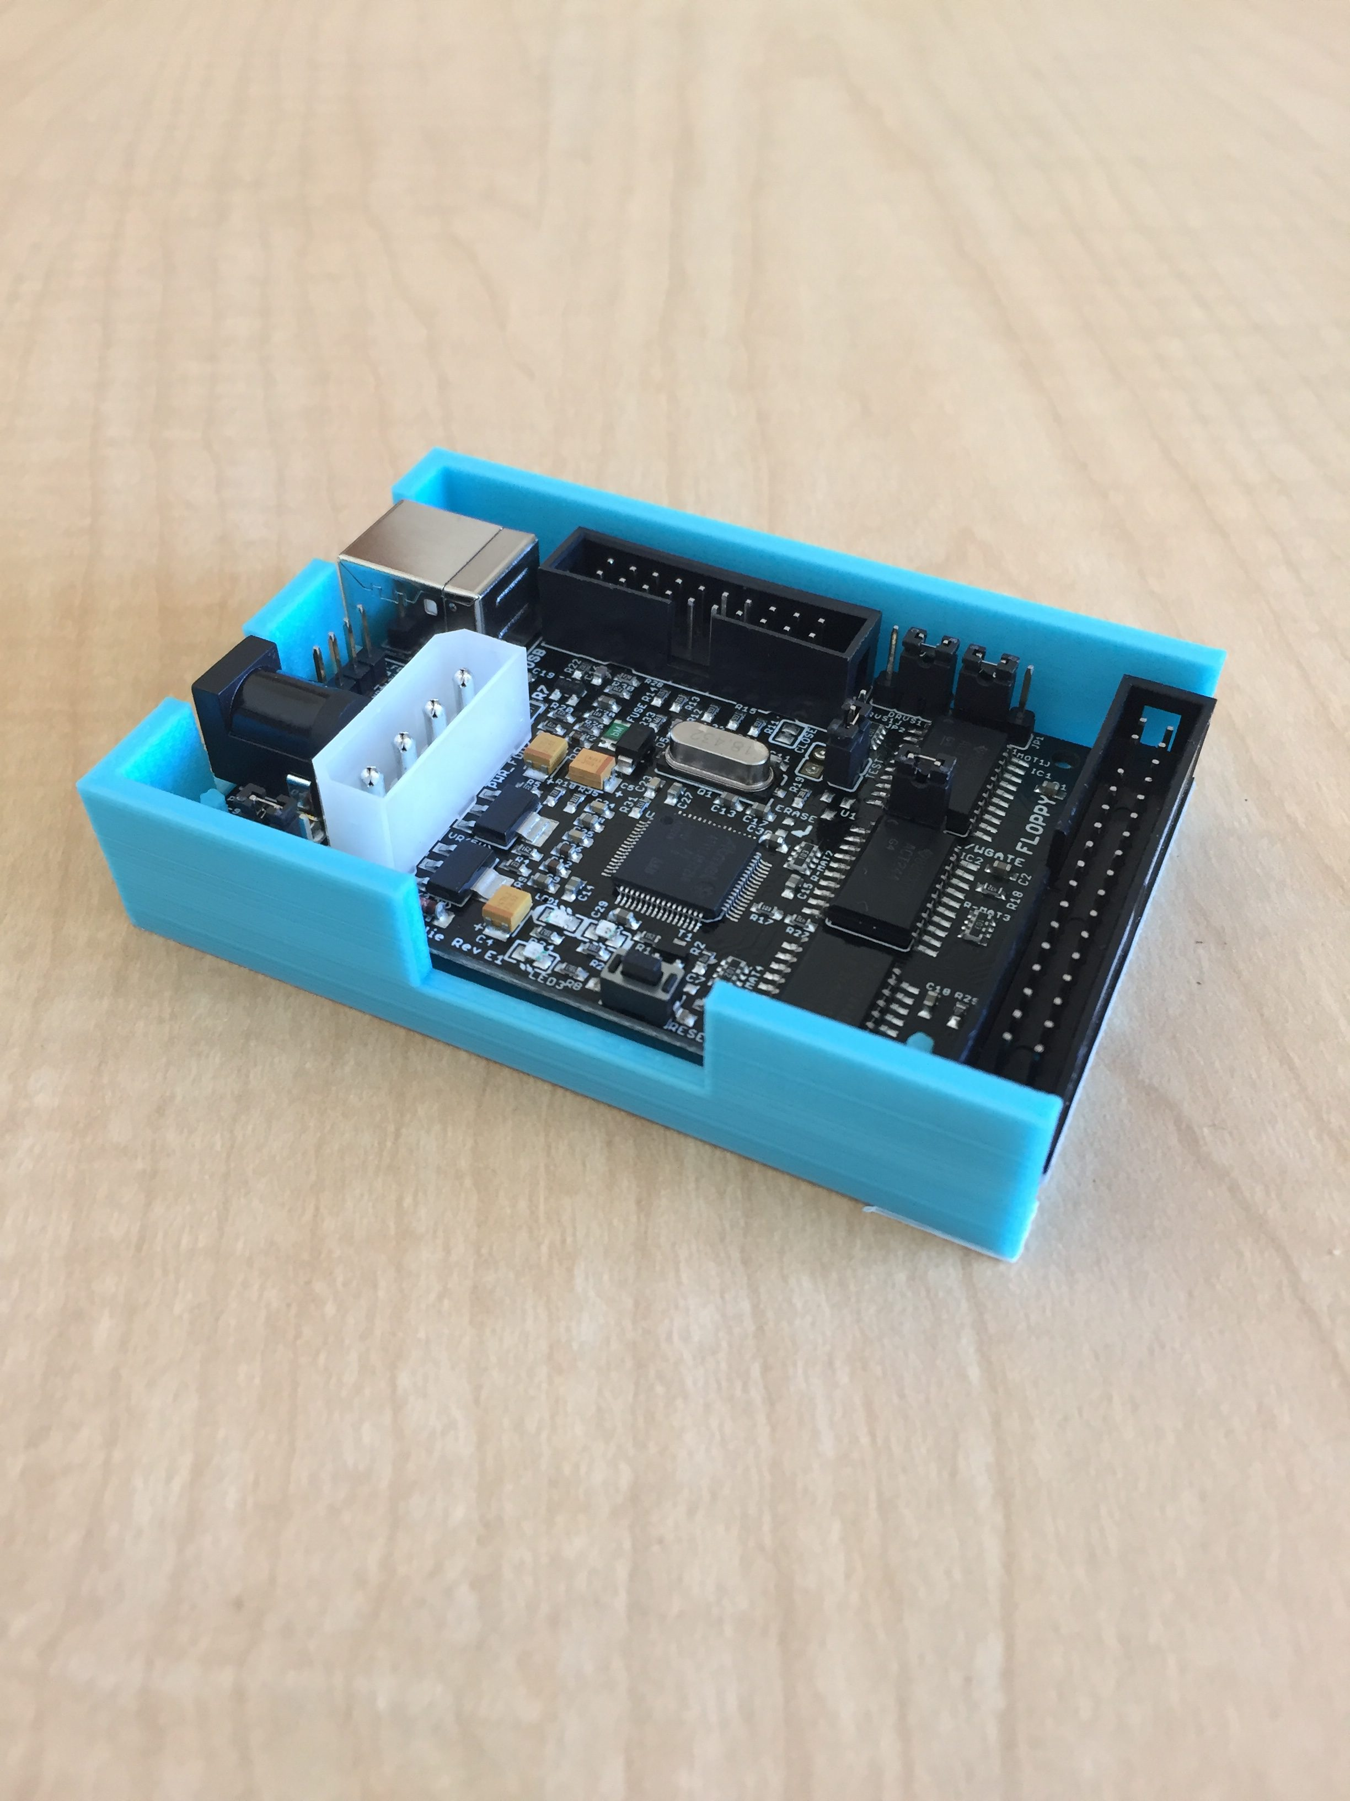
Lab Design & Service
Mission (August 2018):
To support and centralize the technical processing and analysis of digital storage media and digital files from special collections.
Jessica Venlet | @jessvenlet | August 2, 2019 | SAA Research Forum

Slide 6
Day in the Life…
Icons: https://thenounproject.com
Intake
Lab
Description
Jessica Venlet | @jessvenlet | August 2, 2019 | SAA Research Forum

Slide 7
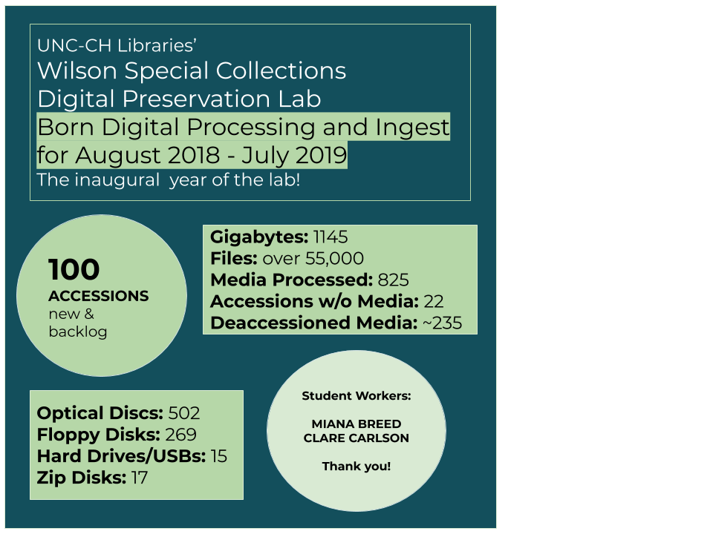
Lab Stats August 2018 – July 2019
Jessica Venlet | @jessvenlet | August 2, 2019 | SAA Research Forum

Slide 8
Some Remaining Questions
Growing the Lab’s capacity and scope. Better understanding of how it should be staffed and where it fits in our organization.
Appraisal, appraisal, appraisal
DigiPres Strategy
Jessica Venlet | @jessvenlet | August 2, 2019 | SAA Research Forum

Slide 9
Some Resources on Staffing & BD
Yale Library Digital Accessioning and Support Service
Princeton blog post from Elvia Arroyo-Ramirez, Kelly Bolding, and Faith Charlton
Rockefeller Archive Center blog post from Bonnie Gordon
University of Minnesota E-Records Taskforce
Jessica Venlet | @jessvenlet | August 2, 2019 | SAA Research Forum

